Slide 1
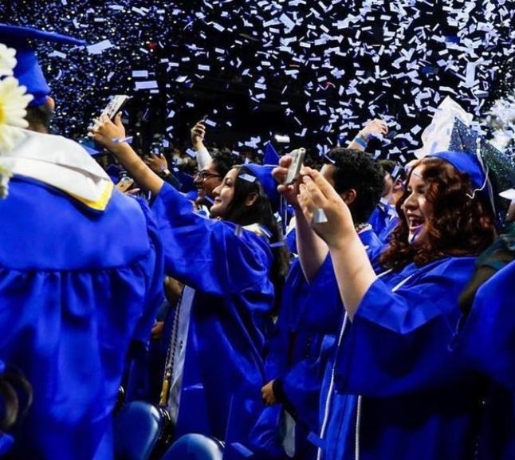
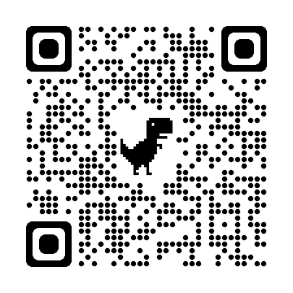
Class of 2026
Rialto High School
02 AUGUST 2022
Freshman Registration
06
02
22
Please sign-in
rialtohighkinghts

Slide 2
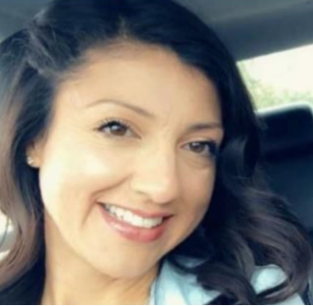
RHS Administrative Team
Germaine A. Gray
Assistant Principal
Sophmore Academy
FFESHMAN CLASS OF 2026
Linda Merino
Dr. Sweeny
Assistant Principal
Junior Academy
Principal
Johanna Cuellar
Michael Pfiffer
Assistant Principal
Freshman Academy
Assistant Principal
Senior Academy

Slide 3
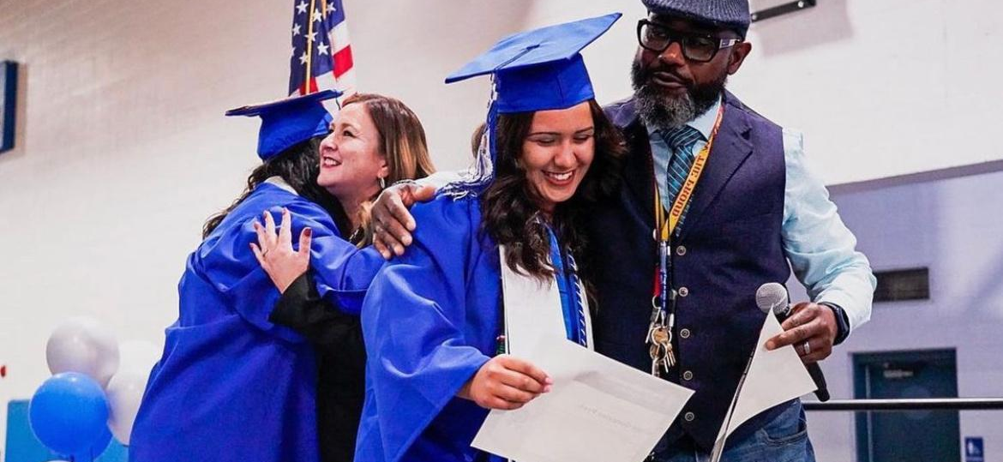
Counselors
Guiding students in developing their educational and career plans
Support Students by Alpha
FRESHMAN CLASS | RHS |
Mrs. Bertodo
Mrs. Williams
A-Char
Perej-Sam
Mrs. Conner
Mrs. Amanda
Wellness Center
Social & Emotional Support
Chas-Gomez
Sanchez-Z
Mrs. Gomez
Mr. Piggue
Gon-Malag
Identified
Mrs. Castillo
Ms. Johnson
Malah-Pereira

Slide 4
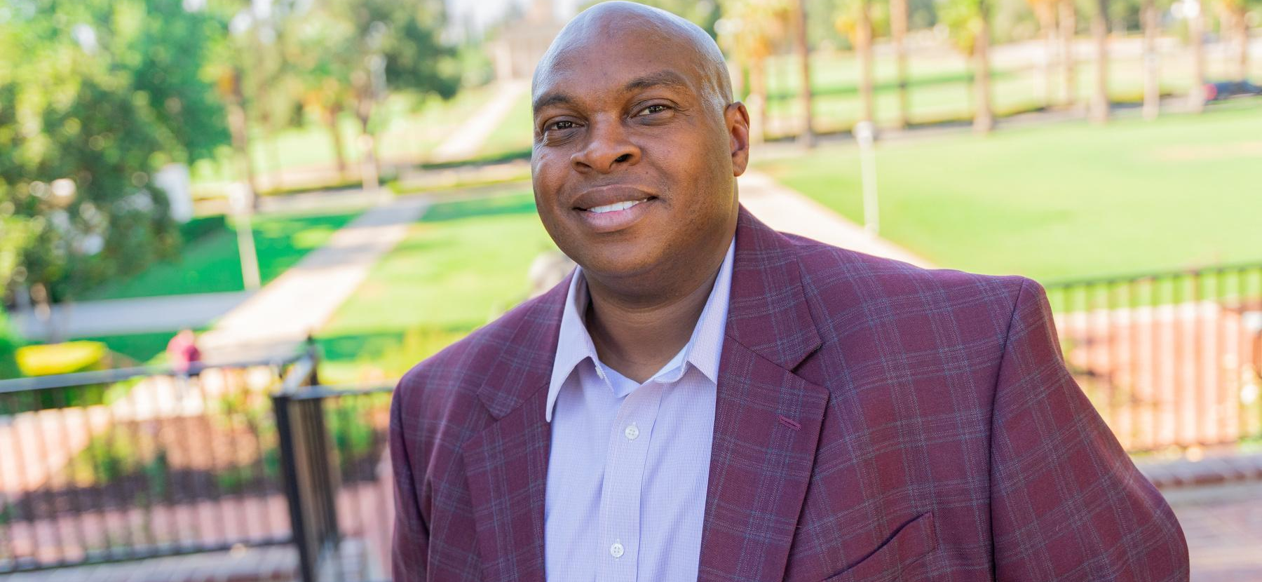
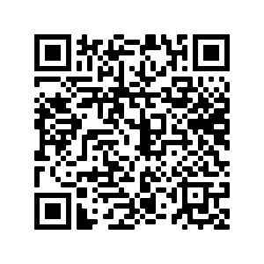
TBS
Theraputic Support Strategist
Michael Arrington MS , MFT
marringt@rialtousd.org
FRESHMAN CLASS | RHS |
Request for Assistance
Social & Emotional Support

Slide 5
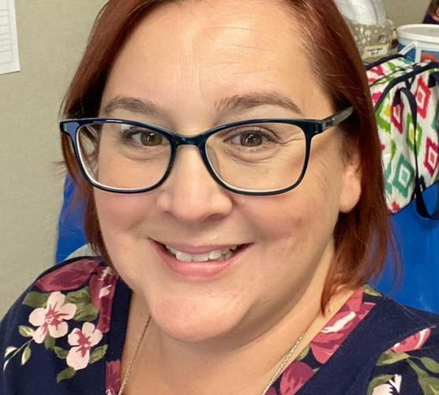
Link Crew
Advisor
Heather Bartlett
hbartlett@rialtousd.org
About Link Crew
Orientation
FRESHMAN CLASS | RHS |
Orientation
Academic Follow-Up
Social Activities
Link Crew Leader Peer Support
8:00 am -12:00 pm
08/03/2022
Drop off
Pick Up

Slide 6
Respect
Classroom
Lunch Area
Hallways
Restrooms
Office/Academies
Community
School Events
PBIS
Responsibility
School Pride
01
02
03
FREHSMAN CLASS | 2026
Cell Phone
Dress Code
School ID
Big 3
Cover and conceal undergarments
Cover and conceal private body parts
Clothing, backpacks & accessories must be free of images/content that display/promote sex, drugs, or tabacco use, firearms or gang related
Devices must be turned off and not visible during instructional time, which is designated by the school's bell schedule.
Requirement
Daily-
Hall Pass
To move around campus
Entrance for event

Slide 7
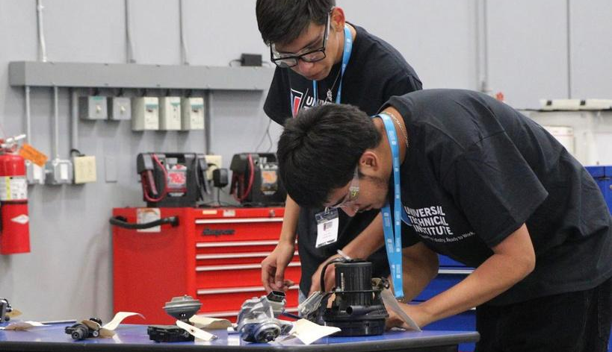
Grades & Credits Matter
FRESHMAN CLASS
Freshman
Sophomore
Junior
Senior
2023
60 credits
Attendance
Grades
2024
120 Credits
Attendance
Grades
2025
180 Credits
Attendance
Grades
2026
220 Credits
Attendance
Grades
All grades must be a C or better

Slide 8
Attendance
Students must be in class and in their seat at 8:40
Vanessa Carrillo (909) 421-7500 ext. 21176
Attendance Calls
Twice Daily
Robo Call, 11:00 & 6:00pm
24 Hour Automated System
(909) 421-7500
Ext. 29205 - English
Ext. 29206 -Spanish
FRESHMAN ACADEMY
02 AUGUST 2022

Slide 9
Transcripts
01
02
Passing Grades
Failing Grades
DOCUMENTS GRADES, COURSES TAKEN, GPA...
5 Credits for each passing grade received
Credits are not awarded. Course may need to be re-taken.
HELPS YOU STAY ON TRACK
FRESHAMN CLASS | 2026
PROGRESS IN SCHOOL
03
04
Credits Needed
Credit Deficiency
60 Credits by end of Freshman Year
220 Credits
A-G Coursework
Summer School
Zero or 7th Period
APEX
Explore alternative learning setting, Milor or Zupanic
What you should know...

Slide 10
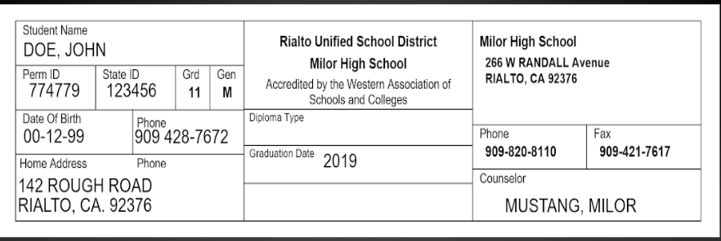
RIDING INTO THE SUNSET
FRESHMAN CLASS 2026
Check your transcripts...

Slide 11
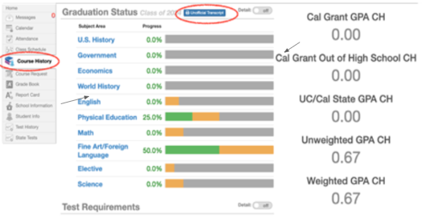
Unofficial Transcripts
Log into STUDENTVUE
2. Click on Unofficial Transcrips
RIDING INTO THE SUNSET
FRESHMAN CLASS 2026
3. Click on Course History

Slide 12
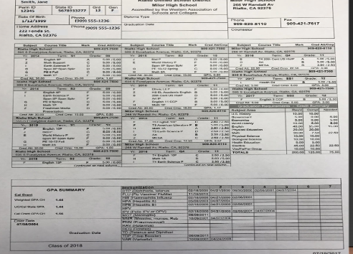
Ask yourself the following
questions:
How many passing grades did you receive?
RIDING INTO THE SUNSET
How many credits were possible?
FRESHMAN CLASS 2026
How many credits did you earn?
Let's take a closer look...

Slide 13
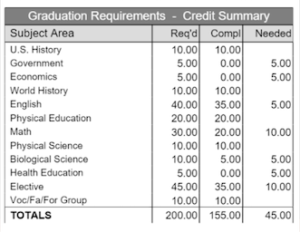
Ask yourself the following
questions:
Needed: What you still need
RIDING INTO THE SUNSET
Compl: What you have earned
FRESHMAN CLASS 2026
Req'd: Total Number of credits needed.
Look at each column
Credit Summary
Look at subject area on each row

Slide 14
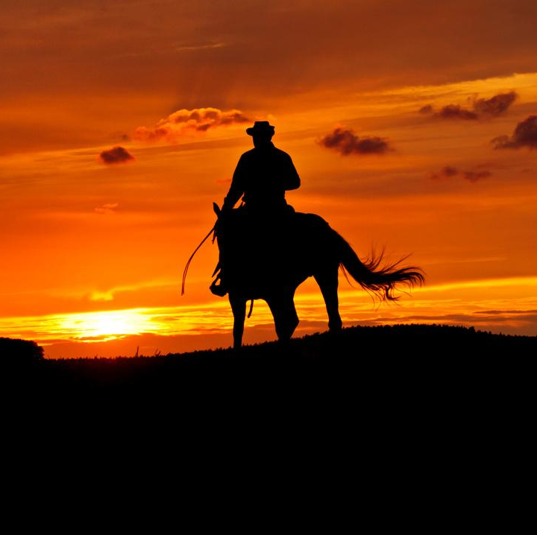
RIDING INTO THE SUNSET
FRESHMAN CLASS 2026
Our Journey...

Slide 15
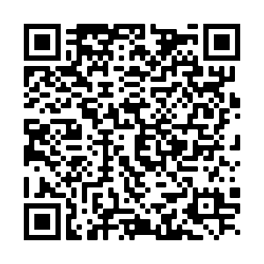
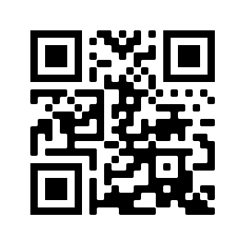
Stay in touch
Freshman
Yanet Arrellano
(909) 421-7500 ext. 21116
How can we help?
Attendance
Vanessa Carrillo
(909) 421-7500 ext. 21176
FRESHMAN ACADEMY
02 AUGUST 2022
Health Office
Remind Ap
Tammy Elssmann
(909) 421-7500
595 S. Eucalyptus Ave., Rialto, CA., 92376
909-421-7500 ext.21116
jcuellar@rialtousd.org
https://kec.rialto.k12.ca.us/rialtohighschool
@rialtohighschoolknights

